Slide 1


G H PATEL COLLEGE OF ENGINEERING AND TECHNOLOGY DESIGN ENGINEERING(2150001) Walkthrough Face Recognition
PRESENTED BY:
Dave Shardul (130110107003)
Shah Jeel (130110107046)
Suthar Hemant (130110107058)
Thakkar Shrinand (130110107059)
Thakkar Virali (130110107060)
GUIDED BY:
Prof. Hetal Gaudani
Prof. Namrata Dave

Slide 2
Contents
Face recognition
Face Detection
Feature Extractions
What is PCA?
Why PCA?
Eigenvalue and Eigenvector basics
Tools used
Pre-Processing
Steps for PCA

Slide 3
Contents
Training Procedure
Testing Procedure
Flow Diagram of PCA
Limitations
Overcomes
Project Implementation
Conclusion
Web References

Slide 4
Face recognition
A face recognition system is automatically identify or verifies a person from a digital figure or a video frame.
Many facial recognition algorithms identify faces by extracting landmarks, or features, from an image of the subject's face.
A human face reveals a great deal of information to a perceiver.
It may tell about mood and intention and attentiveness, but it can also serve to identify a person.
However, a face is the most distinctive and widely used key to a person’s identity.

Slide 5
Face recognition
The problem of automatic face recognition contains three key steps:
1.Detection and rough normalization of faces.
2. Feature extraction and accurate normalization of faces.
3. Identification or verification.

Slide 6
Face Detection
This step is to determine, whether human faces appear in a given image, and where these faces are located at.
The estimated results of this step are patches containing each face in the input image.

Slide 7
Feature Extractions
After the face detection step, human-face patches are extracted from images.
To conquer these drawbacks, feature extractions are performed to do dimension reduction, salience extraction, and noise cleaning.

Slide 8
What is PCA?
The term "principal component" denotes new variables (or coordinate systems) we choose to describe our data in a more concise or convenient way.
principal components analysis (PCA) is a technique that can be used to simplify a dataset. It is a linear transformation that chooses a new coordinate system for the data set such that the greatest variance by any projection of the data set comes to lie on the first axis (called the first principal component), the second greatest variance on the second axis, and so on.

Slide 9
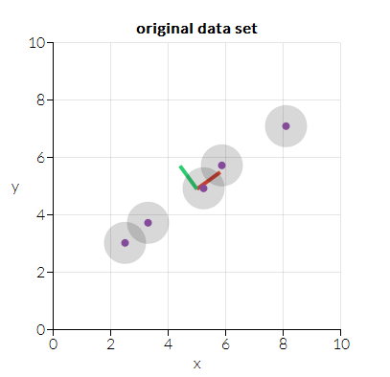
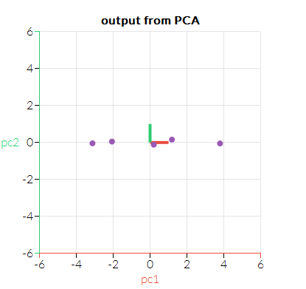
What is PCA?

Slide 10
What is PCA?
PCA can be used for reducing dimensionality in a dataset while retaining those characteristics of the dataset that contribute most to its variance, by keeping lower-order principal components and ignoring higher-order ones. The idea is that such low-order components often contain the "most important" aspects of the data.

Slide 11
Why PCA?
The basic Benefit in PCA is to reduce the dimension of the data.
With help of PCA, complexity of grouping the Images can be reduced.
Application of PCA in the prominent field of criminal investigation is beneficial.
PCA also benefits entrance control in buildings, access control for computers in general, for automatic teller machines in particular, day-to-day affairs like withdrawing money from bank account, dealing with the post office, passport verification, and identifyIng the faces in a given databases.

Slide 12
Eigenvalue and Eigenvector basics
In linear algebra, an eigenvector or characteristic vector of a square matrix is a vector that does not change its direction under the associated linear transformation.
In other words—if v is a vector that is not zero, then it is an eigenvector of a square matrix A if Av is a scalar multiple of v.
This condition could be written as the equation
Av= λv

Slide 13
Eigenvalue and Eigenvector basics
where λ is a number (also called a scalar) known as the eigenvalue or characteristic value associated with the eigenvector v.
Geometrically, an eigenvector corresponding to a real, nonzero eigenvalue points in a direction that is stretched by the transformation and the eigenvalue is the factor by which it is stretched.
If the eigenvalue is negative, the direction is reversed.

Slide 14
Tools used
Computer
Webcam
VLC Media Player
Python with OpenCV library

Slide 15
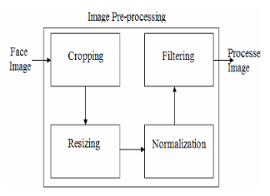
Pre-Processing

Slide 16
Pre-Processing
Cropping:
-Detect the face and crop it.
Resizing:
-Resize an Image.
Normalizing:
-To make the lighting conditions and contrast of an image uniform.
Filtering:
-To make image de-noisy.

Slide 17
Steps for PCA:
Training Procedure
Testing Procedure

Slide 18
Training Procedure
Take K input images.
(2) Reduce size of image by ¼ to make faster computation.
(3) Reshape image and convert the image into column major matrix. If image size is M x N then the reshaped image will be (M*N) x 1.

Slide 19
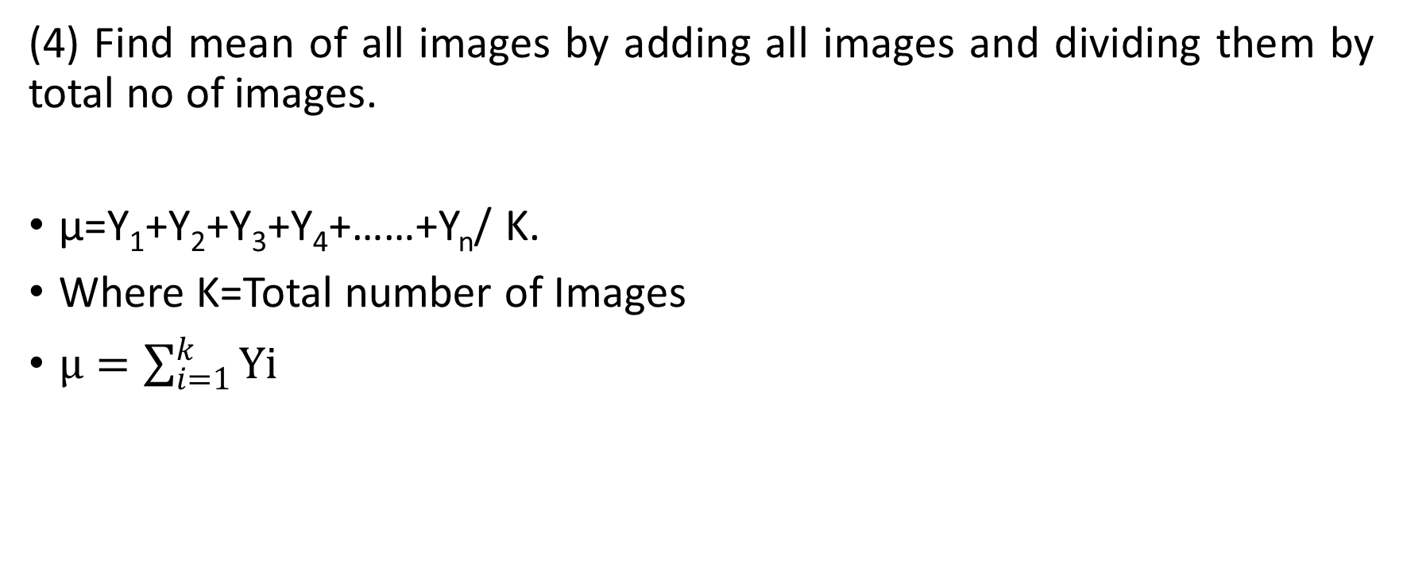
Training Procedure
(4) Find mean of all images by adding all images and dividing them by total no of images.
µ=Y₁+Y₂+Y₃+Y₄+……+Y_{n}/ K.
Where K=Total number of Images
$µ=\sum_{i=1}^{k}{Yi}$

Slide 20
Training Procedure
(5) Subtracting the mean image from each of the training images centers the training images. The mean image is a column vector such that each entry is the mean of all corresponding pixels of the training images. We’ll subtract mean µ from all the images.
Y_{i}=Y_{i}-µ;

Slide 21
Training Procedure
(6) Now Collect all column major matrices into one matrix to create data matrix called MS whose dimension will be
MS(M*N,K)
Where K=Total number of training images (variable).
(7) Find Covariance which is calculated by multiplying Mean subtracted image and it’s transpose.
€ = MS*MS^{T}

Slide 22
Training Procedure
(8) Find Eigen values and Eigen Vectors of Covariance €. Then arrange Eigen values in descending order and then take first n number of Eigen vectors which are enough for face recognition.
(9) Find U which is calculated by multiplying mean subtracted image and selected Eigen vectors’ matrix and using U calculate Eigen Faces £ by,
U=MS* €
£=U^{T}*MS

Slide 23
Testing Procedure
(10) For testing take an image and subtract mean from that image and reshape it to get column major matrix.
(11) Multiply this result with transpose of U.
Test=U^{T}*TestImage
(12) Compare this Test matrix with number of Eigen faces and find Euclidean distance and find minimum distance which is our recognized image.

Slide 24
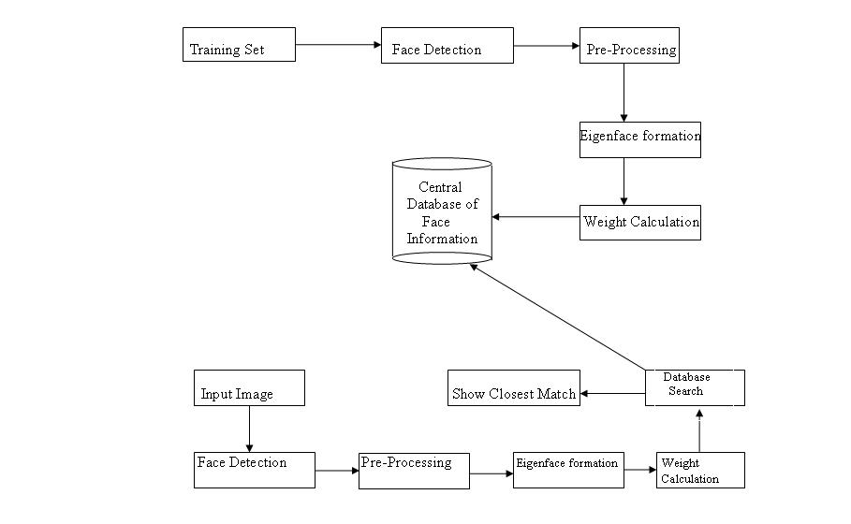
Flow Diagram of PCA

Slide 25
Limitations
it suffers from two major limitations:
(1) poor discriminatory power and
large computational load.
- The computational cost for finding eigenvectors from the auto-correlation matrix M is in cubic complexity O(d^3).

Slide 26
Overcomes
However, this approach suffers from the limitations mentioned earlier.
To resolve these limitations, we proposed a new method to use
PCA - applying PCA on the wavelet subband 4.
LDA – linear discriminant analysis.

Slide 27
Overcomes
Benefits of PCA - applying PCA on the wavelet subband 4.
- By decomposing an image using WT, the resolutions of the subband images are reduced. In turn, the computational complexity will be reduced dramatically by working on a lower resolution image.
Benefits of LDA
-maximize the discriminatory power.

Slide 28
Project Implementation

Slide 29
Contents
Overall Project Architecture
Training set
Test Image
Eigen Face
Result
Analysis
Efficiency

Slide 30
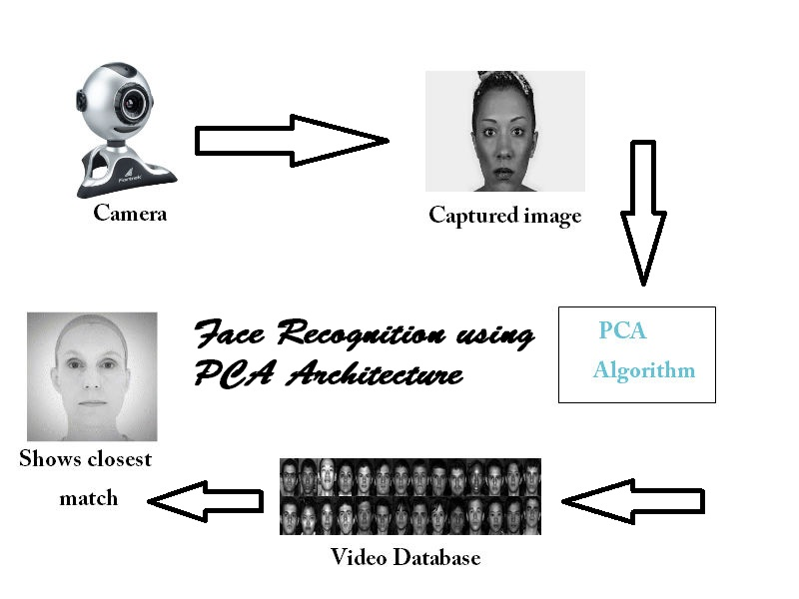
Overall Project Architecture

Slide 31
Training set

Slide 32
Test Image

Slide 33
Mean Face

Slide 34
Eigen Face

Slide 35
Result

Slide 36
Analysis

Slide 37
Efficiency

Slide 38
Conclusion

Slide 39
Web References
http://setosa.io/ev/principal-component-analysis/
http://mengnote.blogspot.in/2013/05/an-intuitive-explanation-of-pca.html
http://www.researchgate.net/publication/235950165_FACE_RECOGNITION_USING_PRINCIPAL_COMPONENT_ANALYSIS_AND_NEURAL_NETWORKS
http://citeseerx.ist.psu.edu/viewdoc/download?doi=10.1.1.108.7863&rep=rep1&type=pdf
http://www.ijarcsse.com/docs/papers/Volume_3/6_June2013/V3I6-0202.pdf
http://www.indjst.org/index.php/indjst/article/viewFile/48455/41978
http://www.ijcaonline.org/volume10/number8/pxc3872019.pdf
http://ethesis.nitrkl.ac.in/3814/1/Thesis.pdf

Slide 40


Slide 41


